Slide 1
Social media website Web Design Final Project Proposal
Team members：
Fangning He, Fei Li, Yunlu Zhou, Zhiyi Wang

Slide 2
Why social media?
Web page must be attractive.
Look into business logic functionality.
Flexibility of dynamic page.

Slide 3
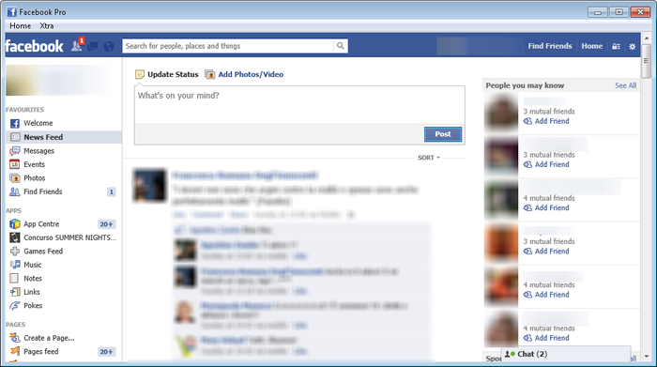
Current Social Media

Slide 4
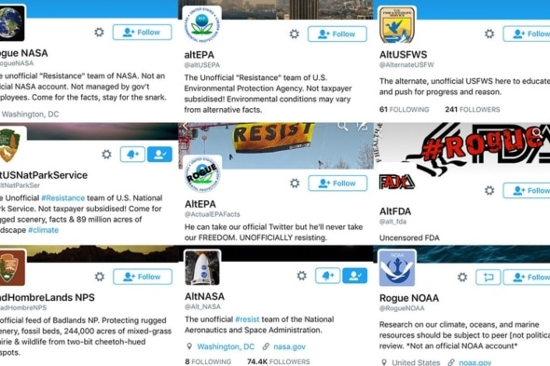
Current Social Media

Slide 5
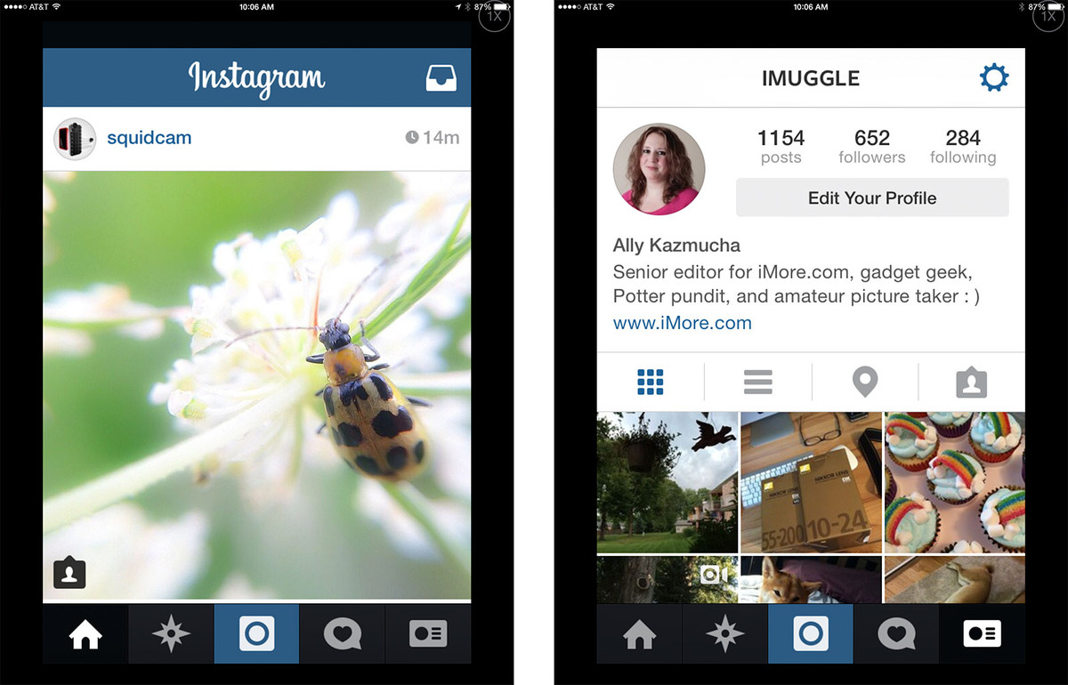
Current Social Media

Slide 6
Basic Function:
Register/Login/Logout
Create profile
Search a friend/ a event
Add/Remove a friend
Post/delete/comment

Slide 7
Features:
Timeline/Event photo film/animation
Initiate/Join events/group message
Tag members on post/link tag to other’s homepage
Recommend friends or events
Friends circle based on events
Detail of the upcoming events(direction, add to calendar)

Slide 8
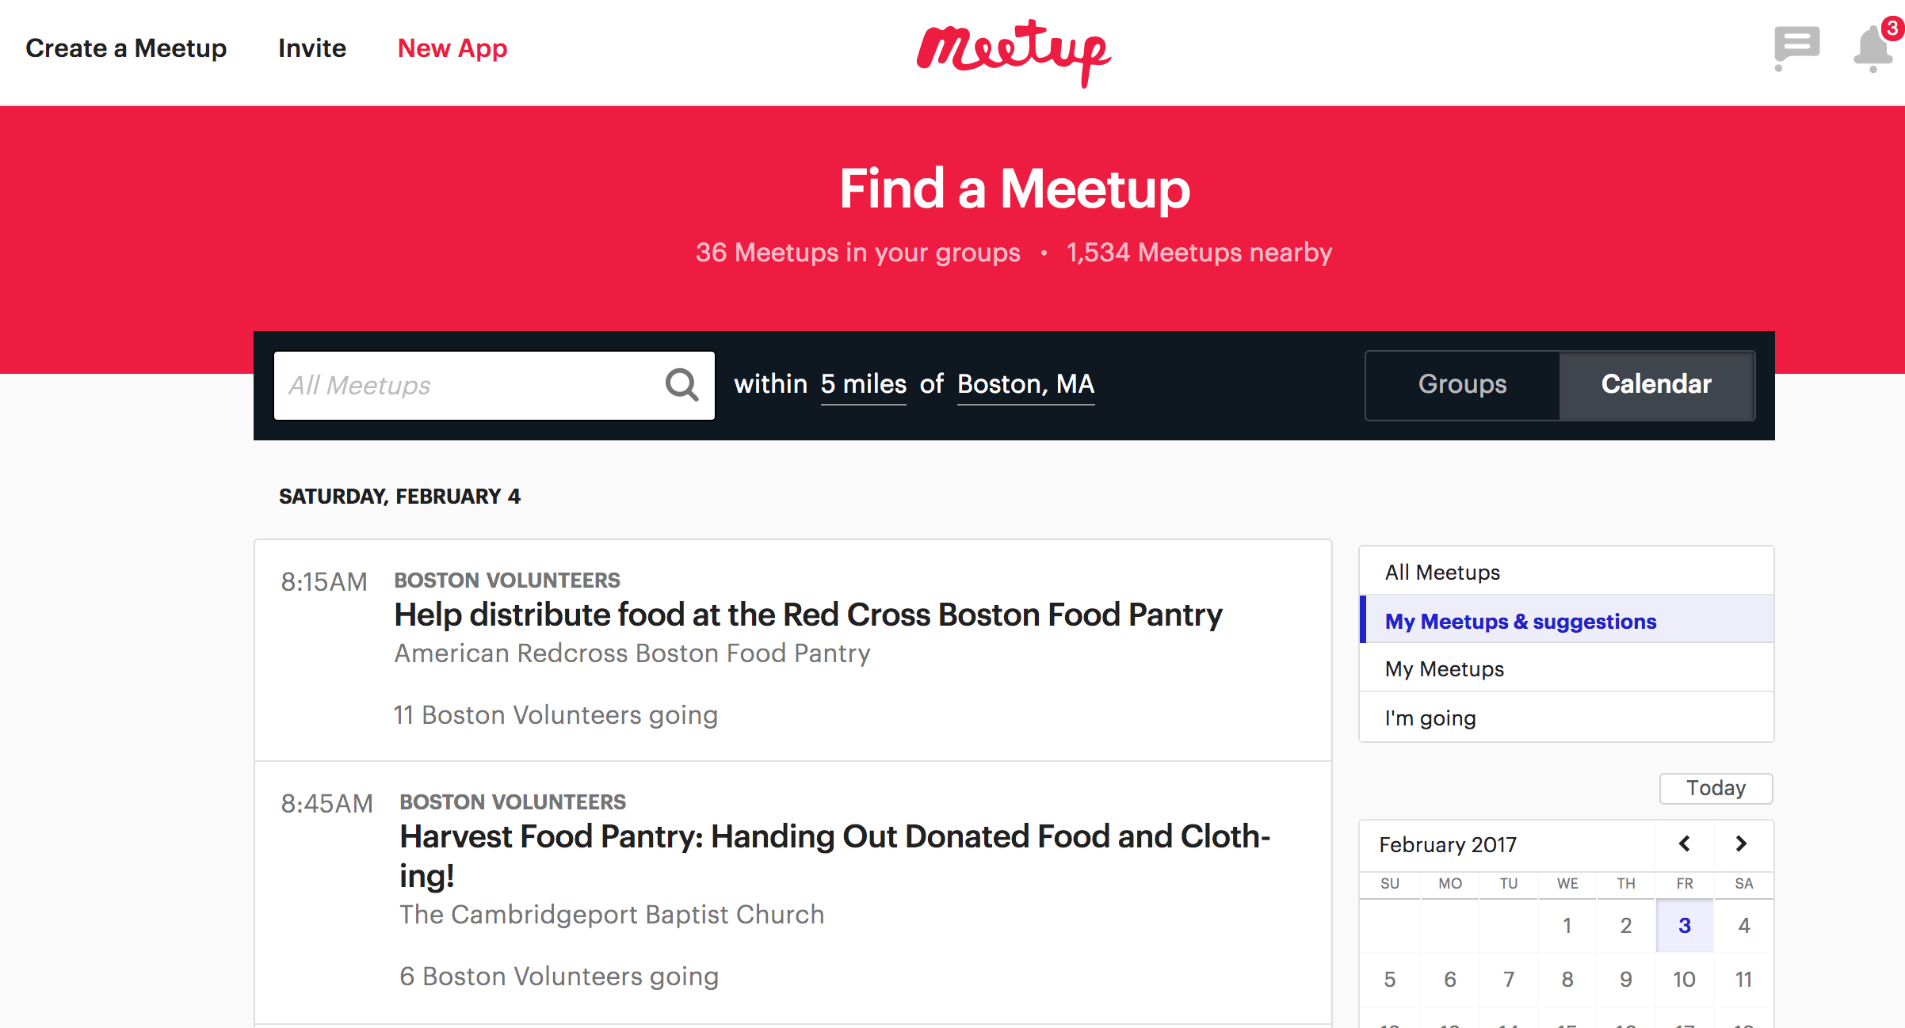

Slide 9
Challenges/Goals:
Clear and concise layout
Interactive user experience using AJAX/Javascript
Timeline/photo story: personal/moving
Event management: easy to organize and informative

Slide 10
Data Flow

Slide 11





Web Technologies
Front End Design:
Back End Functionality:

Slide 12






Software Integration

Slide 13
Questions:
Ditr

